Slide 1
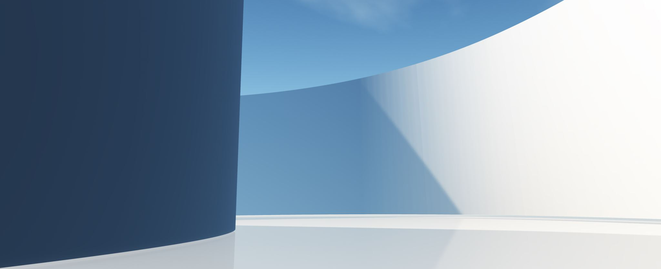
Week 20
Espruino Tools

Slide 2
Progress
Design
Wrote a first draft for the design section.
Implementation
Wrote a first draft for the implementation section.
Evaluation
Made a plan for the evaluation wrote about testing and user study.
Changed the content of evaluation (show on overleaf)

Slide 3
Progress(cont.)
Conclusion
Made a plan for the conclusion section

Slide 4
Questions
What is looked for from the evaluation section? I have testing, speed comparisons and a survey on teaching (im going to use this in the introduction)
How many references do I need in the bibliography? Does a small amount of references mean the dissertation will be marked bad, should all my links be bibliography references as well as clickable links?
What should the presentation cover? What gets marks in the presentation, how can I cover everything without being vague? Which demos should I show

Slide 5
Questions (cont.)
How is the software product section of the marking scheme checked? Will the marker just look over the repositories or will there be a deep dive into specifics
How should I show my demos off in the dissertation? Is a table in the appendix with package name, short description and a link enough?

Slide 6
Demos
Plan (bare minimum)
Pixl – playing game with mobile, (core, peer)
Robot – getting a custom Espruino device to do something (core)
If there is time
Puck -hand tracking to control LED brightness based on finger position (core, peer (video))

Slide 7
What’s Left?
Evaluation
Conclusion
Second Draft
Demos

